Slide 1
Development of master curricula for natural disasters risk management in Western Balkan countries
WP1.3 – Key elements for new curricula for WB HEIs
DI Kurt Glock
University of Natural Resources and Life Sciences BOKU, Vienna
Workshop Workshop on master curricula best practices in EU partners
7th April 2017
Project number: 573806-EPP-1-2016-1-RS-EPPKA2-CBHE-JP
"This project has been funded with support from the European Commission. This publication reflects the views only of the author, and the Commission cannot be held responsible for any use which may be made of the information contained therein"

Slide 2
Analysis of EU master curricula
Development of master curricula for natural disasters risk management in Western Balkan countries
Requirements for risk management of natural disasters
Well-developed professionals
Appropriate knowledge
→ Responsibility of national institutes including universities → Development of special master curricula
→ Including appropriate courses in existing master curricula

Slide 3
Analysis of EU master curricula
Development of master curricula for natural disasters risk management in Western Balkan countries
Overview of master´s degree programmes related to NDRM
Nation | Number of master´s degree programmes | Universities
Austria | 4 | University of Natural Resources and Life Sciences Vienna, BOKU (2) Graz University of Technology, TU Graz Vienna University of Technology, TU Wien
Greece | 1 | Technological Educational Institute of Eastern Macedonia and Thrace and Fire Brigade Academy
Italy | 4 | School of Advanced Studies IUSS Pavia, University of Patras, University of Grenoble Alpes, Middle East Technical University University of Cagliari, Interuniversity Consortium for Hydrology (CINID), Autonomous Region of Sardinia University of Thessaly, Hellenic Open University, Università degli Studi di Messina, Universitat de Barcelona University of Salemo
United Kingdom | 15 | Kings College London University College London Northumbria University Durham University University of Portsmouth Coventry University University of Huddersfield University of Manchester University of Salford University of South Wales University of Lincoln University of Leicester
Denmark | 1 | University of Copenhagen
Germany | 2 | University of Bonn Bauhaus-University Weimar
Sweden | 1 | Lund University
The Netherlands | 1 | University of Twente
Total: | 29
ANZAHL!!!

Slide 4
Catalogue of competencies
Development of master curricula for natural disasters risk management in Western Balkan countries
Requirements on employees:
Skills for an integral management of natural hazards
b) Technical know-how for necessary construction measures
c) Fundamental knowledge about valid natural hazard legislation
d) Soft skills like communication, presentation and project management

Slide 5
Catalogue of competencies
Development of master curricula for natural disasters risk management in Western Balkan countries
a) Skills for an integral management of natural hazards
a.1) Capabilities for managing multidisciplinary holistic approaches
a.2) Competences for developing and executing strategic perspectives within relevant policy and operational frameworks
a.3) Skills for planning and managing emergency and crisis situations
a.4) Competences for developing and evaluating alternatives for decision-making

Slide 6
Catalogue of competencies
Development of master curricula for natural disasters risk management in Western Balkan countries
b) Technical know-how for necessary construction measures
b.1) Holistic knowledge about typical natural hazards (Types, development, recurrence intervals, causes, etc.)
b.2) Technical understanding of constructions (Planning, designing, construction, etc.)
b.3) Skills for consideration the effects of implemented measures (short-term & long-term, up- & downstream)
b.4) Competences to find sustainable and environmental-friendly solutions

Slide 7
Catalogue of competencies
Development of master curricula for natural disasters risk management in Western Balkan countries
c) Fundamental knowledge about valid natural hazard legislation
c.1) Fundamental knowledge about national legal situation c.2) Awareness about higher-level permissions (EU Floods Directive, EU Water Framework Directive, etc.)
c.3) Knowledge about responsible institutes and authorities

Slide 8
Catalogue of competencies
Development of master curricula for natural disasters risk management in Western Balkan countries
Soft skills Soft skills Soft skills Soft skills Soft skills Soft skills
“Lawyer”
“Manager“
“Technician”
“Lawyer”

Slide 9
Occupational fields
Development of master curricula for natural disasters risk management in Western Balkan countries
• Public authorities (federal, provincial, municipal)
• Structural and civil engineers
• Scientific research institutes (Universities, research centre, etc.)
• Emergency services
• NGO´s
• etc.

Slide 10
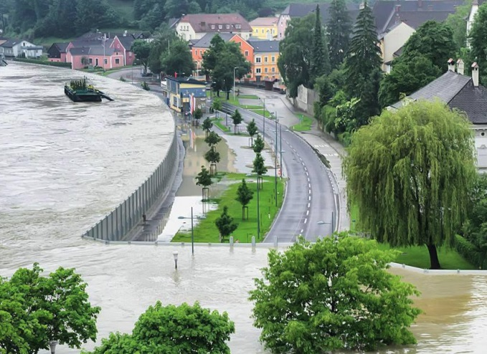
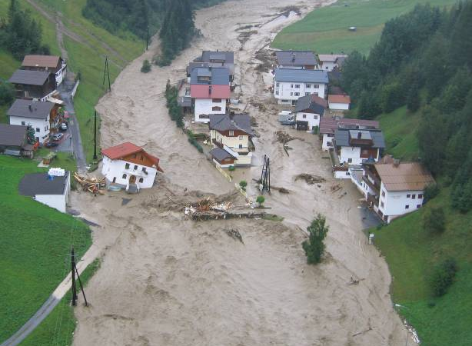
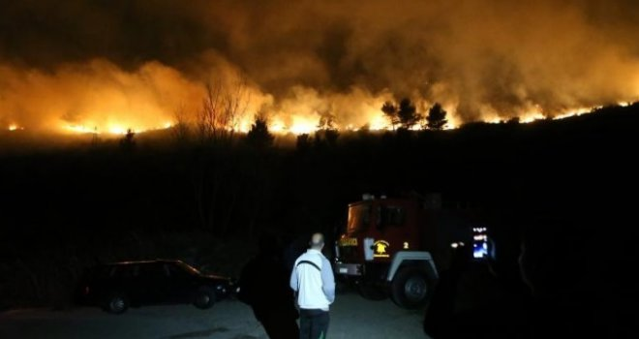
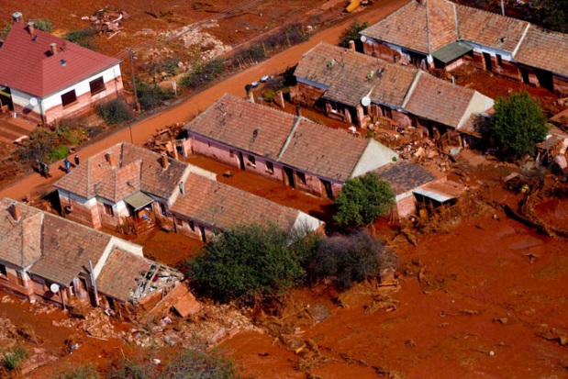
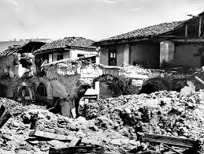
Discussion / Questions ?
Development of master curricula for natural disasters risk management in Western Balkan countries

Slide 11
Contact information
Development of master curricula for natural disasters risk management in Western Balkan countries
University of Natural Resources and Life Sciences Vienna (BOKU)
Department of Water, Atmosphere and Environment (WAU)
Institute of Water Management, Hydrology and Hydraulic Engineering (IWHW)
Kurt Glock
Dipl.-Ing.
E-mail: kurt.glock@boku.ac.at
Michael Tritthart
Priv.-Doz. Dipl.-Ing. Dr.techn.
E-mail: michael.tritthart@boku.ac.at

